Slide 1
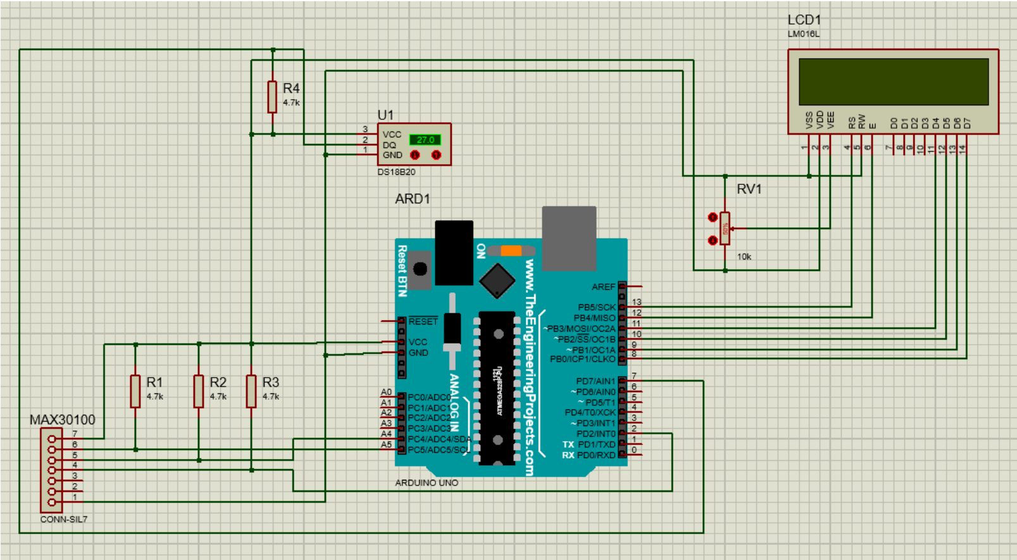







Empowering Lives Through IoT-Based Patient Monitoring using Arduino
EEE 416 – Microprocessor & Embedded System Laboratory
July 2023 Level – 4 Term – 1
Final Project Demonstration
Submitted by – Group 01
Md. Hasan Newaz
1906135
Md. Asif Kabir
1906153
Tamim Hasan Bhuiyan
1906154
Md. Shipon Hossain
1906155
Muntasir Billah
1906162

Slide 2
Outline
Summary
Introduction
Design
Implementation
Analysis and Evaluation
References
Presented by: 1906135

Slide 3
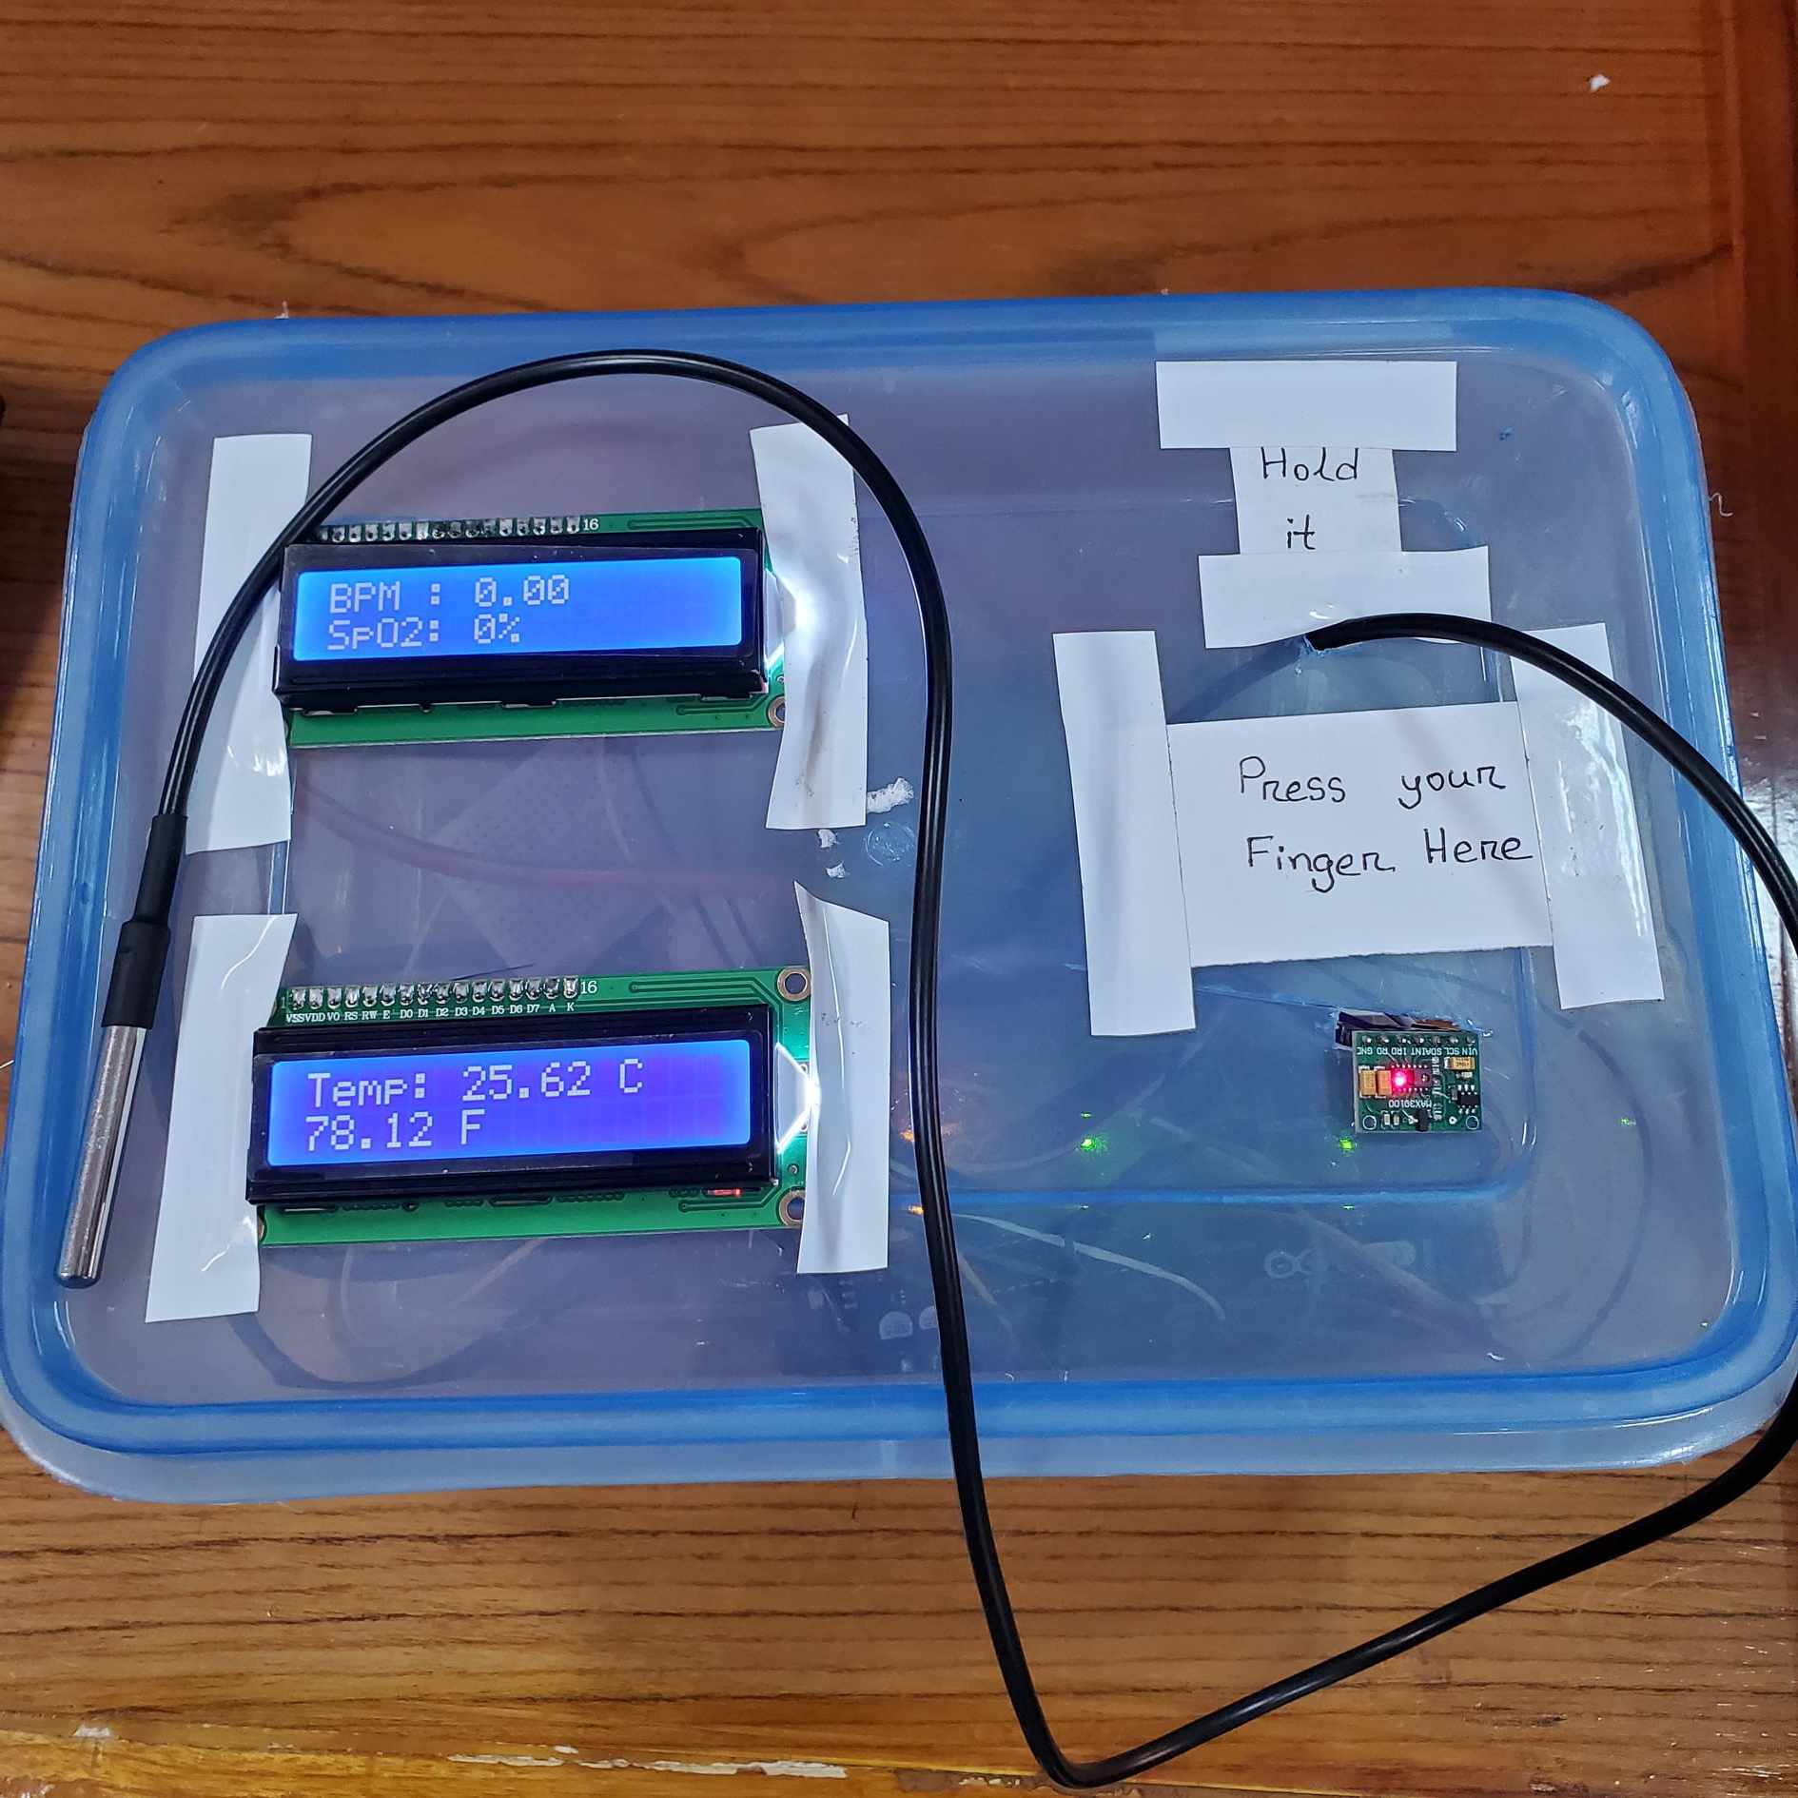
1. Summary / Abstract
Presented by: 1906135

Slide 4

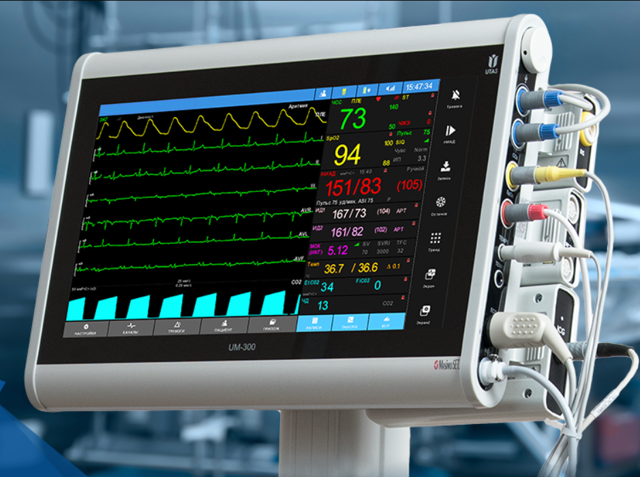
2. Introduction
Problem
Solution
Presented by: 1906135

Slide 5
3.1 Design: Problem Formulation (PO(b))
3.1.1 Identification of Scope
• Hardware Selection
• Microcontroller
Platform
• Software Development
• System Assembly
• Functionality Testing
• Medical Certification
• Advanced Data Analysis
• Power Management
• Clinical Validation
Presented by: 1906135

Slide 6
3.1 Design: Problem Formulation (PO(b))
3.1.3 Formulation of Problem
• Inefficiency
• Potential Inaccuracy
• Limited Data Capture
• Continuous Monitoring
• Automated Data Collection
• Real-Time Data Visualization
Presented by: 1906135

Slide 7
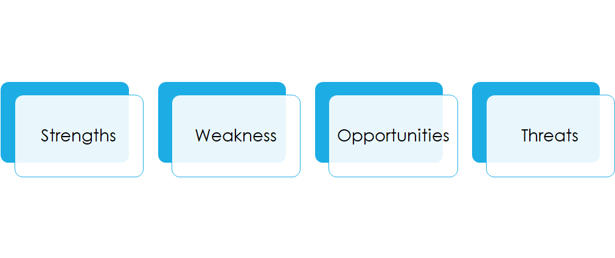
3.1 Design: Problem Formulation (PO(b))
3.1.4 Analysis
Presented by: 1906135

Slide 8
3.2 Design Methods (PO(a))
Identifying Needs and Requirements
Conceptual Design and Research
System Design and Development
Prototyping and Testing
PCB design and making a compact design
Security and Privacy
Evaluation and Refinement
Presented by: 1906135

Slide 9
3.3 Design: Circuit Diagram
Presented by: 1906155

Slide 10
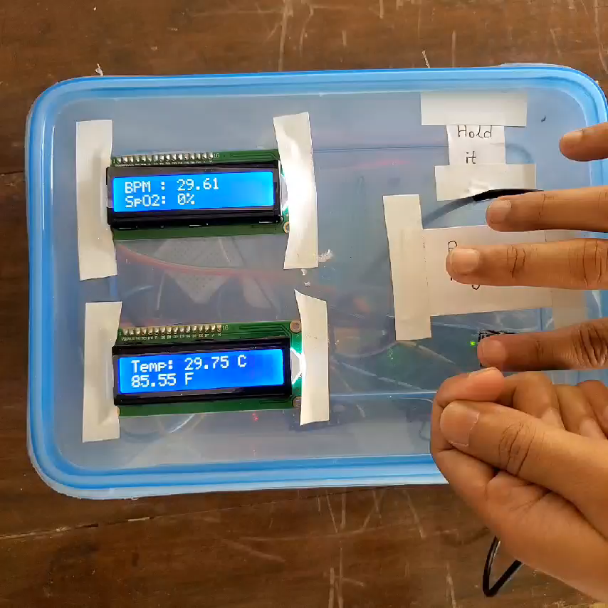
3.4 Design: Simulation
Presented by: 1906155

Slide 11
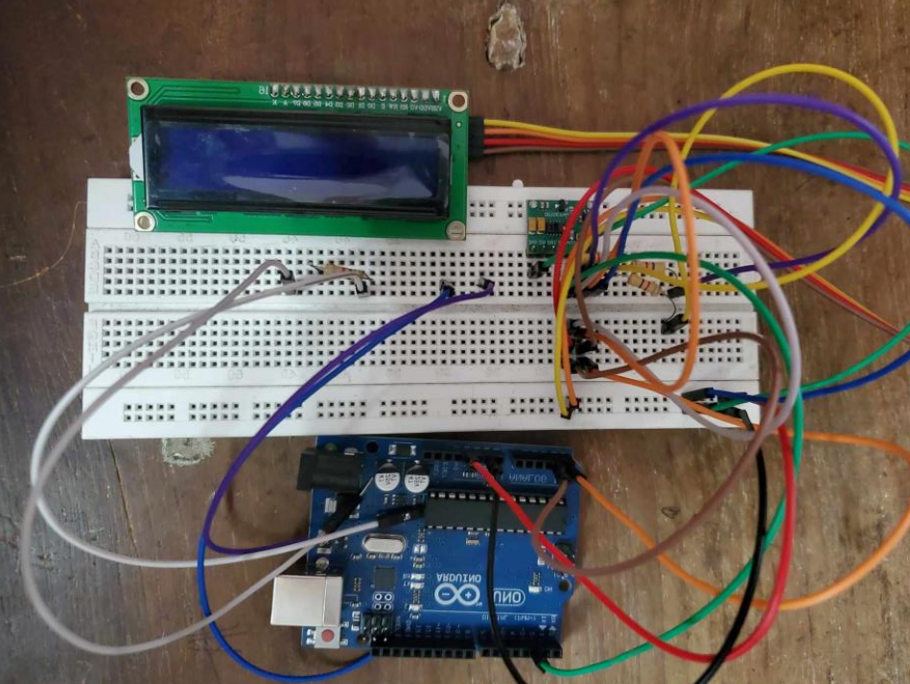
3.5 CAD/Hardware Design
Presented by: 1906155

Slide 12
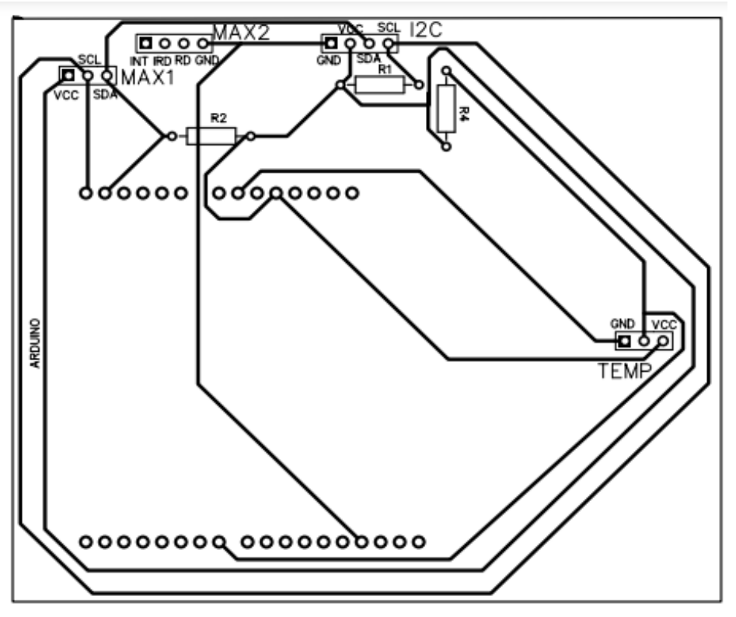
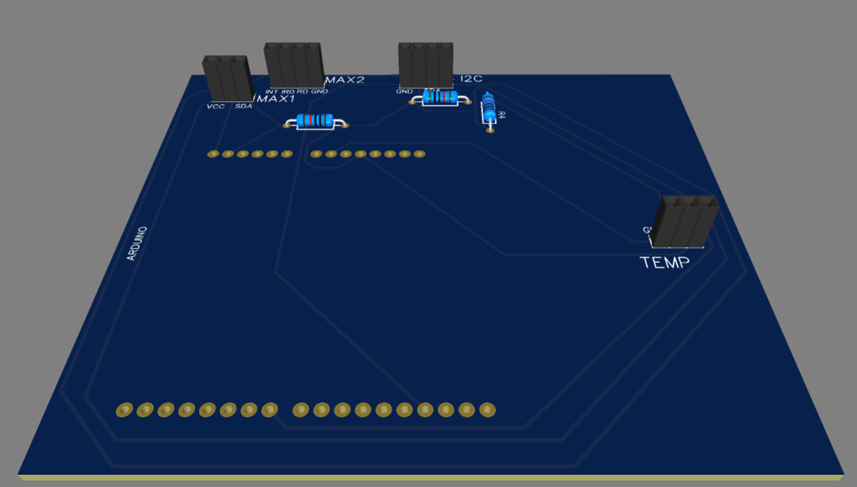
3.6 Design: PCB Layout and 3d rendering
Presented by: 1906155

Slide 13
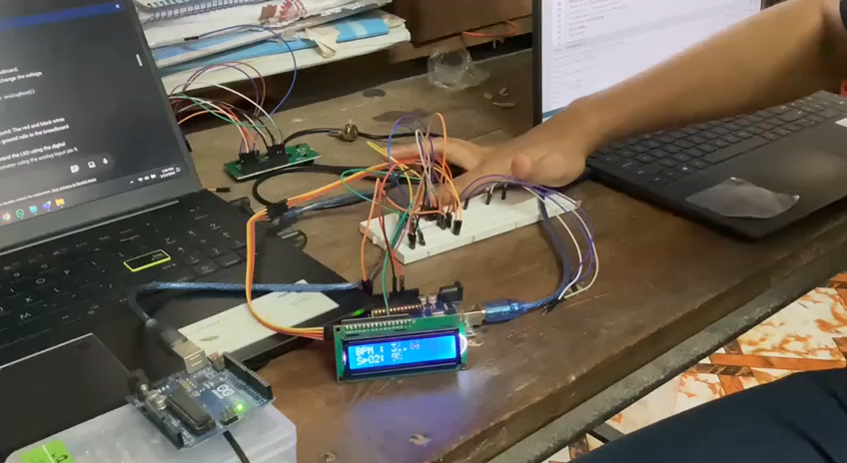
4 Implementation: Demonstration
Presented by: 1906155

Slide 14
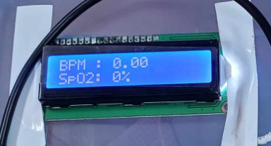
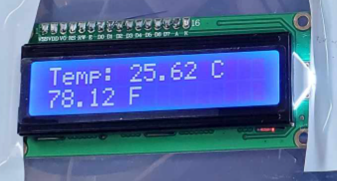
4.1 Implementation: Photo Gallary
Presented by: 1906155

Slide 15
5. Design Analysis and Evaluation
5.1 Novelty
5.2 Design Considerations (PO(c))
5.3 Investigations (PO(d))
5.4 Limitations of Tools (PO(e))
5.5 Impact Assessment (PO(f))
5.6 Sustainability and Envaronmental Impact Evaluation (PO(g))
5.7 Ethical Issues (PO(h))
Presented by: 1906154

Slide 16
5.1 Novelty
Focus on Cost-Effectiveness
Open-Source Platform
Simplicity and Ease of Use
Presented by: 1906154

Slide 17
5.2 Design Considerations (PO(c))
5.2.1 Considerations to public health and safety
Limited Scope Disclaimer
Data Security
User Training
Potential for Improved Patient Care
5.2.2 Considerations to environment
E-waste Management
Component Selection
Presented by: 1906154

Slide 18
5.4 Limitations of Tools (PO(e))
Hardware Limitations
Sensor Accuracy
Sensor Range
Arduino Uno Processing Power
Software Limitations
Software Libraries
Data Logging Limitations
Limited Error Handling
User Interface Limitations
LCD Display Size
Lack of User Interaction
Presented by: 1906154

Slide 19
5.5 Impact Assessment (PO(f))
5.5.2 Assessment of Health and Safety Issues
Accuracy and Validation
User Training
Data Security
5.5.3 Assessment of Legal Issues
Regulatory Requirements
Data Privacy Laws
Presented by: 1906154

Slide 20
5.6 Sustainability Evaluation (PO(g))
E-waste Management
Power Consumption
Material Selection
Presented by: 1906153

Slide 21
6. Reflection on Individual and Team work
6.1 Individual Contribution of Each Member
6.2 Mode of TeamWork
6.3 Diversity Statement of Team
6.4 Log Book of Project Impelementation
Presented by: 1906153

Slide 22
6.1 Individual Contribution of Each Member
Component management
Schematic diagram design & PCB design and connection
Circuit building in breadboard and testing
1906162
1906153 & 1906155
1906135 & 1906154
Presented by: 1906153

Slide 23
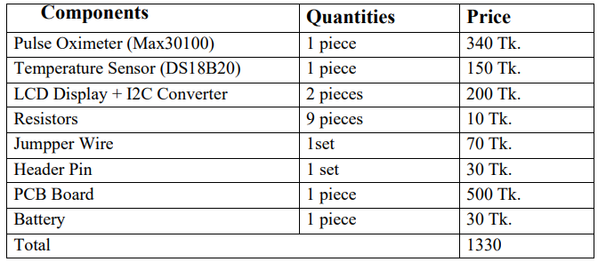
8. Project Management and Cost Analysis (PO(k))
Presented by: 1906153

Slide 24
9. Future Work (PO(l))
Expanding Functionality
Incorporate Additional Sensors
Data Logging and Analysis
Alarm Generation
Wireless Communication
Enhancing User Experience
Mobile App Integration
Improved Display
Audio Cues
Advanced Development
Machine Learning Integration
Cloud-based Data Storage
Medical Certification
Presented by: 1906153

Slide 25
10. References
I. https://how2electronics.com/iot-patient-health-monitoring-with-esp8266-arduino
II. https://how2electronics.com/max30100-pulse-oximeter-with-esp8266
Presented by: 1906153

Slide 26
Thank You
Presented by: 1906153

